Slide 1

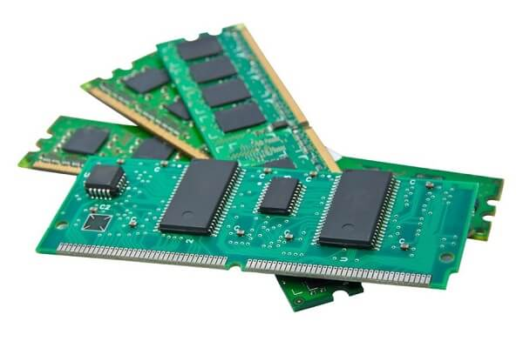
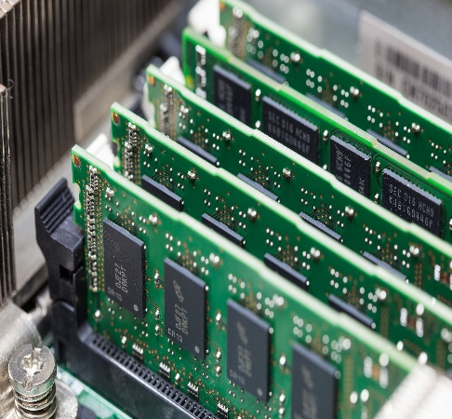
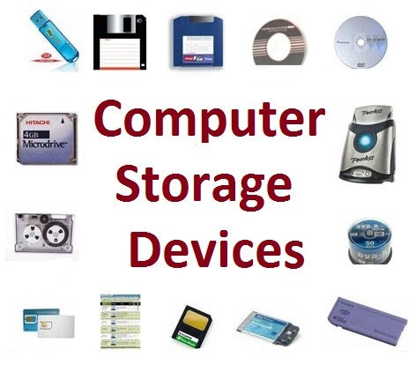
Introduction to Information and Communication Technologies (ICT)
WEEK 3
TOPICS:
Memory and its types
RAM (Random Access Memory)
ROM (Read Only Memory)
Storage Devices

Slide 2
Computer Memory and Its Types
A memory is just like a human brain. It is used to store data and instructions. Computer memory is the storage space in the computer, where data is to be processed and instructions required for processing are stored.
Memory is primarily of three types −
Primary Memory/Main Memory
Secondary Memory
Cache Memory

Slide 3
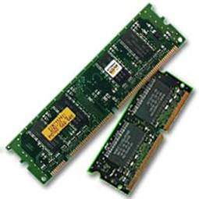
Primary Memory (Main Memory)
Primary memory holds only those data and instructions on which the computer is currently working.
It has a limited capacity and data is lost when power is switched off. It is generally made up of semiconductor device.
These memories are not as fast as registers.
The data and instruction required to be processed resides in the main memory. It is divided into two subcategories RAM and ROM.

Slide 4
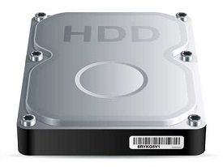
Secondary Memory
This type of memory is also known as external memory or non-volatile.
It is slower than the main memory. These are used for storing data/information permanently.
CPU directly does not access these memories, instead they are accessed via input-output routines. The contents of secondary memories are first transferred to the main memory, and then the CPU can access it. For example, disk, CD-ROM, DVD, etc.

Slide 5
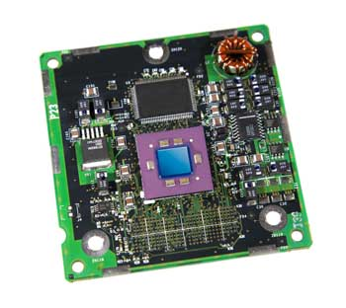
Cache Memory
Cache memory is a very high speed semiconductor memory which can speed up the CPU. It acts as a buffer between the CPU and the main memory.
It is used to hold those parts of data and program which are most frequently used by the CPU. The parts of data and programs are transferred from the disk to cache memory by the operating system, from where the CPU can access them.

Slide 6
Advantages & Disadvantages of Cache Memory
ADVANTAGES | DISADVANTAGES
Cache memory is faster than main memory. | Cache memory has limited capacity.
It stores data for temporary use. | It is very expensive.

Slide 7
Random Access Memory (RAM)
RAM (Random Access Memory) is the internal memory of the CPU for storing data, program, and program result. It is a read/write memory which stores data until the machine is working.
RAM is volatile, i.e. data stored in it is lost when we switch off the computer or if there is a power failure.
RAM is of two types:
Static RAM (SRAM)
Dynamic RAM (DRAM)

Slide 8
Types of Random Access Memory (RAM)
Static RAM (SRAM): In this type of RAM, data is stored using the state of a six transistor memory cell. Static RAM is mostly used as a cache memory for the processor (CPU).
Dynamic RAM (DRAM): It is a type of RAM which allows you to stores each bit of data in a separate capacitor within a specific integrated circuit. Dynamic RAM is a standard computer memory of the many modern desktop computers. This type of RAM is a volatile memory that needs to be refreshed with voltage regularly. Else it loses the information stored on it.

Slide 9
Static RAM vs Dynamic RAM
SRAM | DRAM
SRAM has lower access time, so it is faster compared to DRAM. | DRAM has higher access time, so it is slower than SRAM.
SRAM is costlier than DRAM. | DRAM costs less compared to SRAM.
SRAM requires a constant power supply, which means this type of memory which consumes more power. | DRAM offers reduced power consumption because the information is stored in the capacitor.
It is a complex internal circuitry, and it offers less storage capacity is available compared to the same physical size of a DRAM memory chip. | It is the small internal circuitry in the one-bit memory cell of DRAM. The large storage capacity is available.

Slide 10
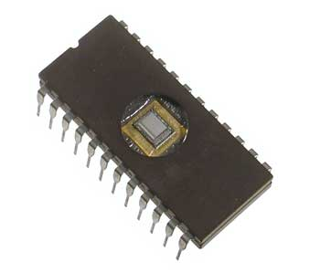
Read Only Memory (ROM)
ROM stands for Read Only Memory. The memory from which we can only read but cannot write on it.
This type of memory is non-volatile. The information is stored permanently in such memories during manufacture.
A ROM stores such instructions that are required to start a computer. This operation is referred to as bootstrap.

Slide 11
Types of Read Only Memory (ROM)
MROM (Masked ROM):
The very first ROMs were hard-wired devices that contained a pre-programmed set of data or instructions. These kind of ROMs are known as masked ROMs, which are inexpensive.
PROM (Programmable Read Only Memory)
PROM is read-only memory that can be modified only once by a user. The user buys a blank PROM and enters the desired contents using a PROM program.
Inside the PROM chip, there are small fuses which are burnt open during programming. It can be programmed only once and is not erasable.

Slide 12
Types of Read Only Memory (ROM)
EPROM (Erasable and Programmable Read Only Memory):
EPROM can be erased by exposing it to ultra-violet light for a duration of up to 40 minutes. Usually, an EPROM eraser achieves this function.
EEPROM (Electrically Erasable and Programmable Read Only Memory):
EEPROM is programmed and erased electrically. It can be erased and reprogrammed about ten thousand times.
Both erasing and programming take about 4 to 10 ms (millisecond). In EEPROM, any location can be selectively erased and programmed.
EEPROMs can be erased one byte at a time, rather than erasing the entire chip. Hence, the process of reprogramming is flexible but slow.

Slide 13
Storage Devices
A hardware device which can be used to store digital data and applications which may be in the form of images, video, audio, etc. is called a storage device. It is a key component of a computer and the hard drive is one of its examples.
Types of Storage Devices:
Magnetic Storage Devices
Optical Storage Devices
Flash Memory Devices
Online Cloud Storage

Slide 14
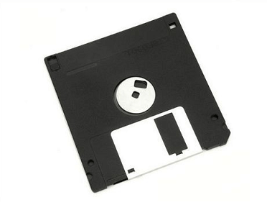
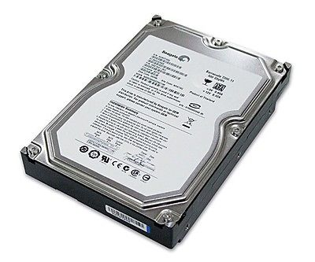
Magnetic Storage Devices
These are affordable and easily accessible. A large amount of data can be stored in these through magnetized mediums.
A magnetic field is created when the device is attached to the computer and with the help of the two magnetic polarities, the device is able to read the binary language and store the information.
Floppy Disk – Also known as a floppy diskette, it is a removable storage device which is in the shape of a square and comprises magnetic elements. When placed in the disk reader of the computer device, it spins around and can store information.
Hard Drive – This primary storage device is directly attached to the motherboard’s disk controller. It is integral storage space as it is required to install any new program or application to the device.

Slide 15
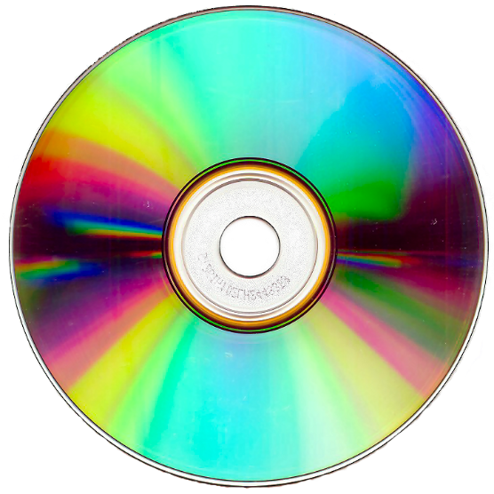
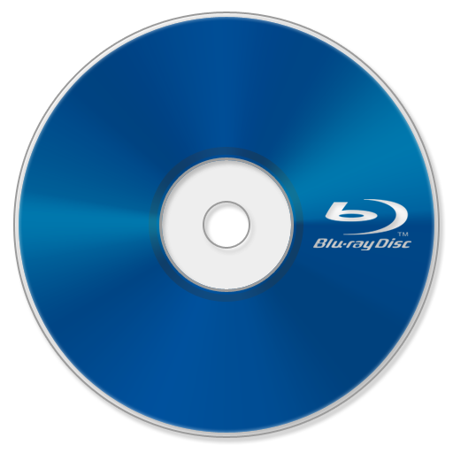
Optical Storage Devices
Such devices used lasers and lights to detect and store data. They are cheaper in comparison to USB drives and can store more data.
CD-ROM – This stands for Compact Disc – Read-Only Memory and is an external device which can store and read data in the form of audio or software data
Blu-Ray Disc – Introduced in 2006, Blu-ray disk was backup up by major IT and computer companies. It can store up to 25 GB data in a single-layer disc and 50 GB data in a dual-layer disc
DVD – Digital Versatile Disc is another type of optical storage device. It can be readable, recordable, and rewritable. Recordings can be done in such devices and then can be attached to the system

Slide 16
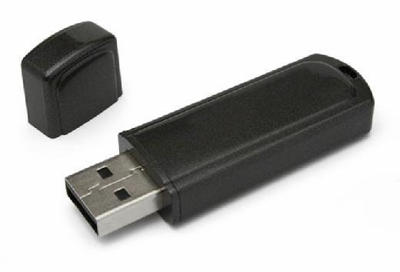
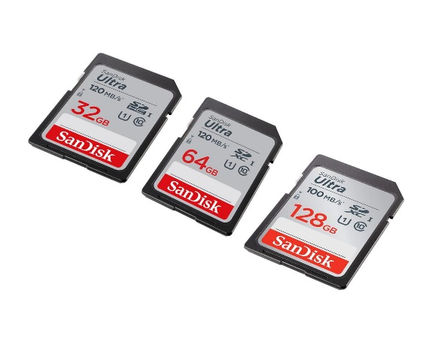
Flash Memory Devices
These storage devices have now replaced both magnetic and optical storage devices. They are easy to use, portable and easily available and accessible. They have become a cheaper and more convenient option to store data.
USB Drive – Also, known as a pen drive, this storage device is small in size and is portable and ranges between storage space of 2 GB to 1 TB. It comprises an integrated circuit which allows it to store data and also replace it.
Memory Card – Usually attached with smaller electronic and computerized devices like mobile phones or digital camera, a memory card can be used to store images, videos and audios and is compatible and small in size
SD Card – Known as Secure Digital Card, it is used in various electronic devices to store data and is available in mini and micro sizes. Generally, computers have a separate slot to insert an SD card.

Slide 17


Online Cloud Storage
The term Cloud computing is used to describe the data centers available for users over the Internet where they can save their databases and files. This data can easily be accessed over the internet anytime and anywhere.
This has become a common mode to store data. The largest or the smallest computerized devices can use the online cloud storage to save their data files. This option is also available in mobile phones where a backup of our files and data is being managed.

